Slide 1
Basic treatment processes
O&M aspects
Health Aspects & Acceptance
Compendium of Sanitation Systems and Technologies

Slide 2
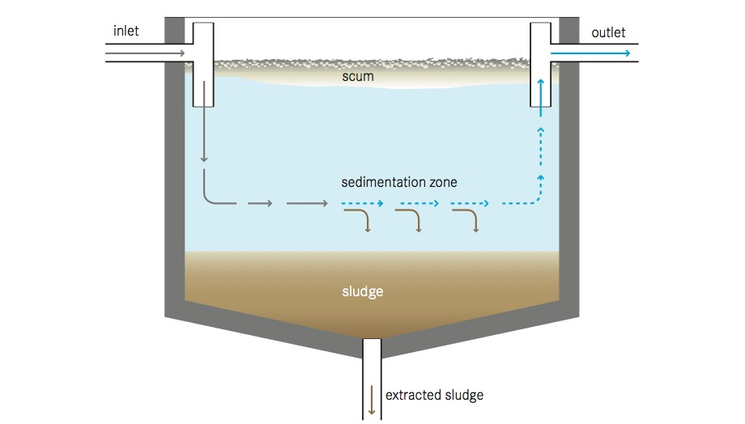
Settler

Slide 3
Operation & Maintenance
In settlers that are not designed for anaerobic processes, regular sludge removal is necessary to prevent septic conditions and the build-up and release of gas which can hamper the sedimentation process by re-suspending part of the settled solids. Sludge transported to the surface by gas bubbles is difficult to remove and may pass to the next treatment stage.
Frequent scum removal and adequate treatment/disposal, either with the sludge or separately, is also important.

Slide 4
Health Aspects & Acceptance
To prevent the release of odorous gases, frequent sludge removal is necessary. Sludge and scum must be handled with care as they contain high levels of pathogenic organisms; they require further treatment and adequate disposal. Appropriate protective clothing is necessary for workers who may come in contact with the effluent, scum or sludge.

Slide 5
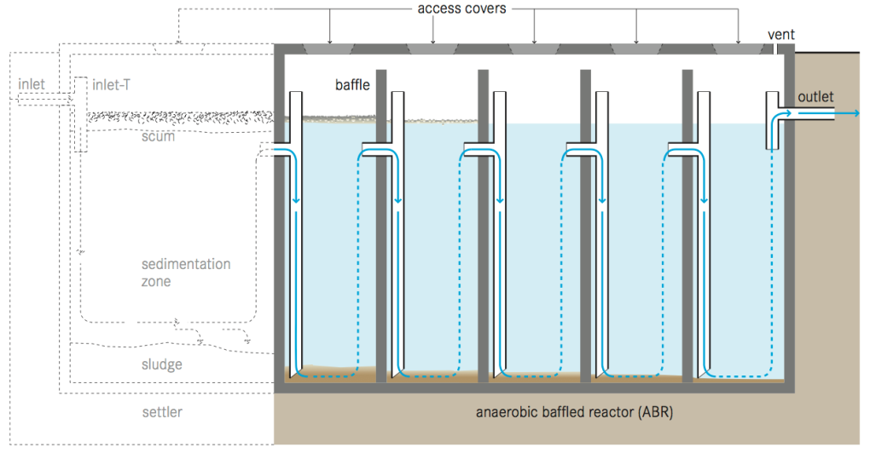
Anaerobic Baffled Reactor (ABR)

Slide 6
Operation & Maintenance
An ABR requires a start-up period of several months to reach full treatment capacity since the slow growing anaerobic biomass first needs to be established in the reactor. To reduce start-up time, the ABR can be inoculated with anaerobic bacteria, e.g., by adding fresh cow dung or septic tank sludge. The added stock of active bacteria can then multiply and adapt to the incoming wastewater. Because of the delicate ecology, care should be taken not to discharge harsh chemicals into the ABR.
Scum and sludge levels need to be monitored to ensure that the tank is functioning well. Process operation in general is not required, and maintenance is limited to the removal of accumulated sludge and scum every 1 to 3 years. This is best done using a Motorized Emptying and Transport technology (C.3). The desludging frequency depends on the chosen pre-treatment steps, as well as on the design of the ABR.
ABR tanks should be checked from time to time to ensure that they are watertight.

Slide 7
Health Aspects & Acceptance
Under normal operating conditions, users do not come in contact with the influent or effluent. Effluent, scum and sludge must be handled with care as they contain high levels of pathogenic organisms. The effluent contains odorous compounds that may have to be removed in a further polishing step.
Care should be taken to design and locate the facility such that odours do not bother community members.

Slide 8
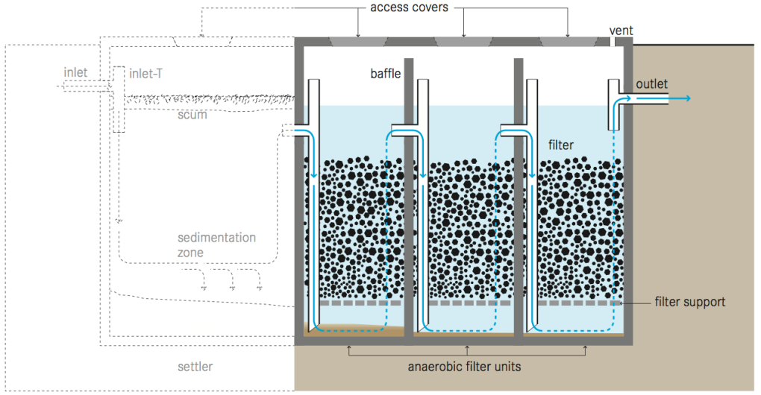
Anaerobic Filter

Slide 9
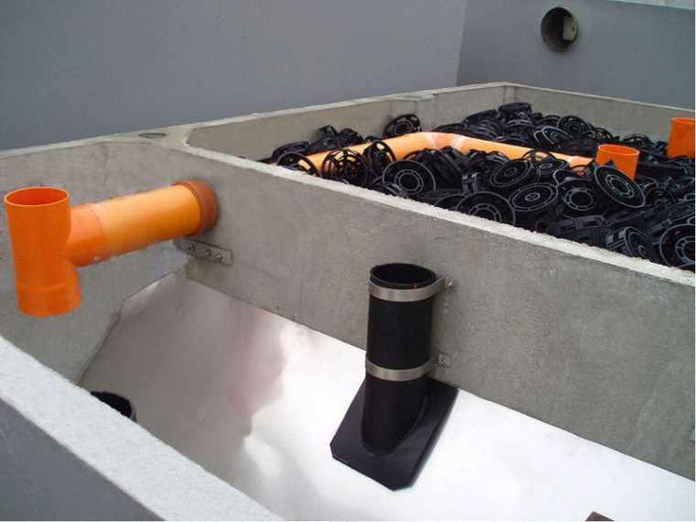

Slide 10
Operation & Maintenance
An anaerobic filter requires a start-up period of 6 to 9 months to reach full treatment capacity since the slow growing anaer- obic biomass first needs to be established on the filter media. To reduce start-up time, the filter can be inocu- lated with anaerobic bacteria, e.g., by spraying Septic Tank sludge onto the filter material. The flow should be gradually increased over time. Because of the delicate ecology, care should be taken not to discharge harsh chemicals into the anaerobic filter.
Scum and sludge levels need to be monitored to ensure that the tank is functioning well. Over time, solids will clog the pores of the filter. As well, the growing bacterial mass will become too thick, break off and eventually clog pores. When the efficiency decreases, the filter must be cleaned. This is done by running the system in reverse mode (backwashing) or by removing and clean- ing the filter material. Anaerobic filter tanks should be checked from time to time to ensure that they are watertight

Slide 11
Health Aspects & Acceptance
Under normal oper- ating conditions, users do not come in contact with the influent or effluent. Effluent, scum and sludge must be handled with care as they contain high levels of path- ogenic organisms. The effluent contains odorous com- pounds that may have to be removed in a further polfishing step. Care should be taken to design and locate the facility such that odours do not bother community members.

Slide 12
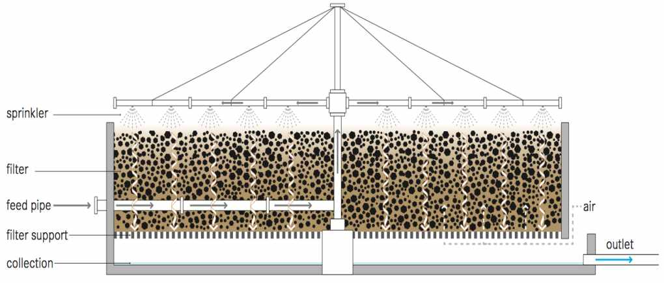
Trickling filter

Slide 13
Operation & Maintenance
A skilled operator is required to monitor the filter and repair the pump in case of problems. The sludge that accumulates on the filter must be periodically washed away to prevent clogging and keep the biofilm thin and aerobic. High hydraulic loading rates (flushing doses) can be used to flush the filter. Optimum dosing rates and flushing frequency should be determined from the field operation.
The packing must be kept moist. This may be problematic at night when the water flow is reduced or when there are power failures.
Snails grazing on the biofilm and filter flies are well known problems associated with trickling filters and must be handled by backwashing and periodic flooding.

Slide 14
Health Aspects & Acceptance
Odour and fly problems require that the filter be built away from homes and businesses.
Appropriate measures must be taken for pre- and primary treatment, effluent discharge and solids treatment, all of which can still pose health risks.

Slide 15
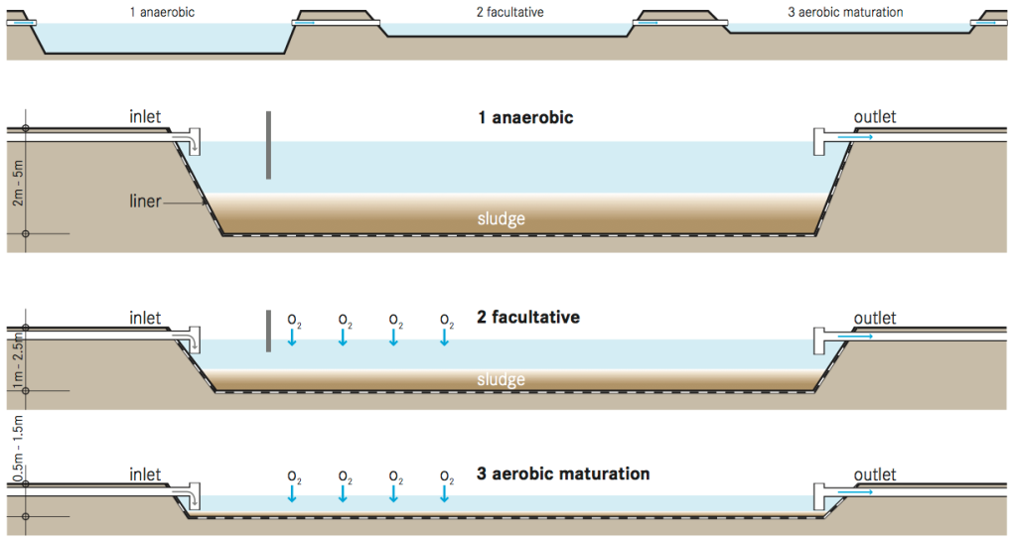
Waste Stabilization Ponds (WSP)

Slide 16
Operation & Maintenance
Scum that builds up on the pond surface should be regularly removed. Aquatic plants (macrophytes) that are present in the pond should also be removed as they may provide a breeding habitat for mosquitoes and prevent light from penetrating the water column.
The anaerobic pond must be desludged approximately once every 2 to 5 years, when the accumulated solids reach one third of the pond volume. For facultative ponds sludge removal is even rarer and maturation ponds hardly ever need desludging. Sludge can be removed by using a raft-mounted sludge pump, a mechanical scraper at the bottom of the pond or by draining and dewatering the pond and removing the sludge with a front-end loader.

Slide 17
Health Aspects & Acceptance
Although effluent from aerobic ponds is generally low in pathogens, the ponds should in no way be used for recreation or as a direct source of water for consumption or domestic use.

Slide 18
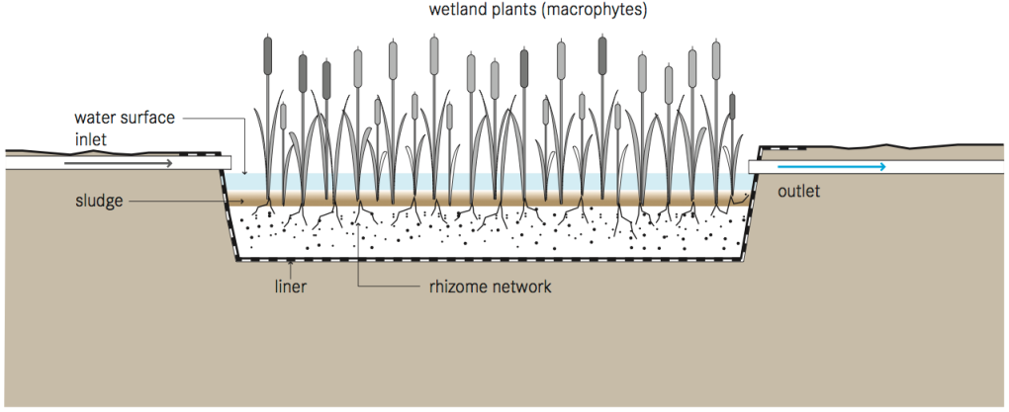
Free-Water Surface Constructed Wetland

Slide 19
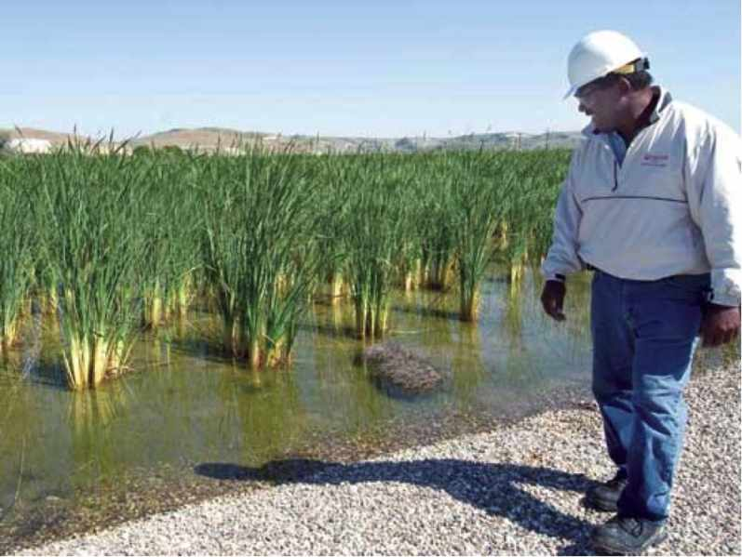

Slide 20
Operation & Maintenance
Regular maintenance should ensure that water is not short-circuiting, or backing up because of fallen branches, garbage, or beaver dams blocking the wetland outlet.
Vegetation may have to be periodically cut back or thinned out.

Slide 21
Health Aspects & Acceptance
The open surface can act as a potential breeding ground for mosquitoes. However, good design and maintenance can prevent this. Free-water surface constructed wetlands are generally aesthetically pleasing, especially when they are integrated into pre-existing natural areas.
Care should be taken to prevent people from coming in contact with the effluent because of the potential for disease transmission and the risk of drowning in deep water.

Slide 22
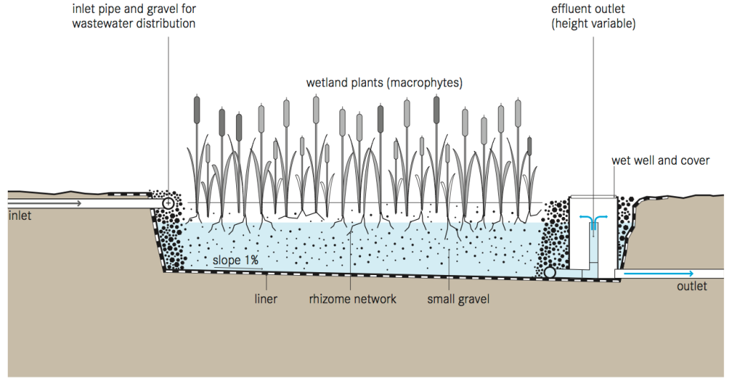
Horizontal Subsurface Flow Constructed Wetland

Slide 23
Operation & Maintenance
During the first growing season, it is important to remove weeds that can compete with the planted wetland vegetation. With time, the gravel will become clogged with accumulated solids and bacterial film.
The filter material at the inlet zone will require replacement every 10 or more years. Maintenance activities should focus on ensuring that primary treatment is effective at reducing the concentration of solids in the wastewater before it enters the wetland.
Maintenance should also ensure that trees do not grow in the area as the roots can harm the liner.

Slide 24
Health Aspects & Acceptance
Significant pathogen removal is accomplished by natural decay, predation by higher organisms, and filtration. As the water flows below the surface, any contact of pathogenic organisms with humans and wildlife is minimized.
The risk of mosquito breeding is reduced since there is no standing water compared to the risk associated with Free-Water Surface Constructed Wetlands (T.7). The wetland is aesthetically pleasing and can be integrated into wild areas or parklands.

Slide 25
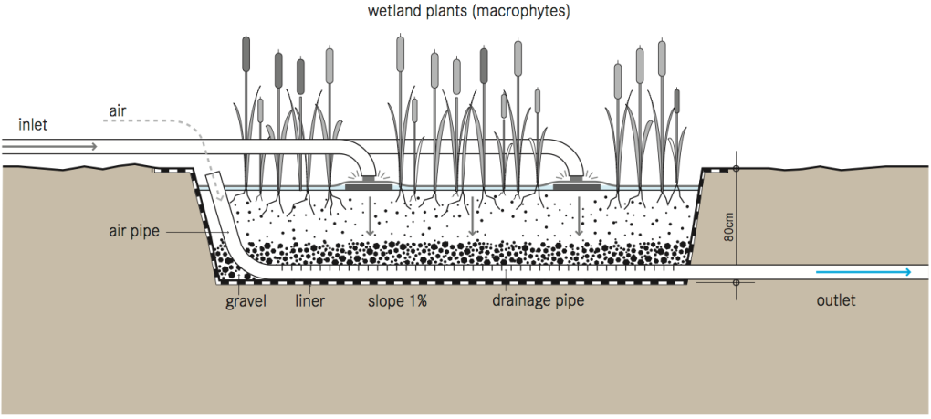
Vertical Flow Constructed Wetland

Slide 26
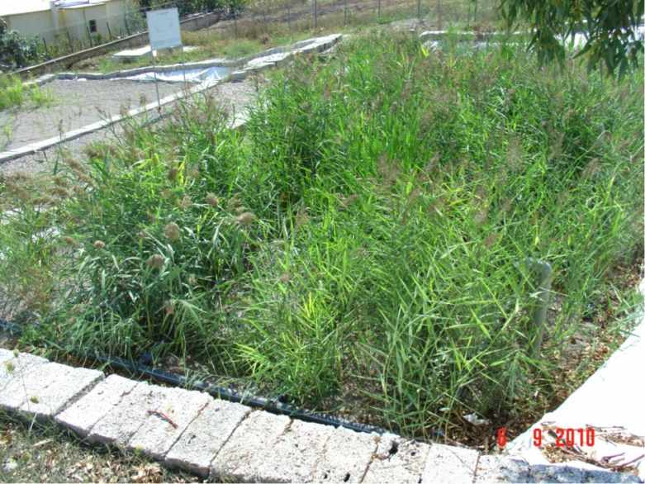
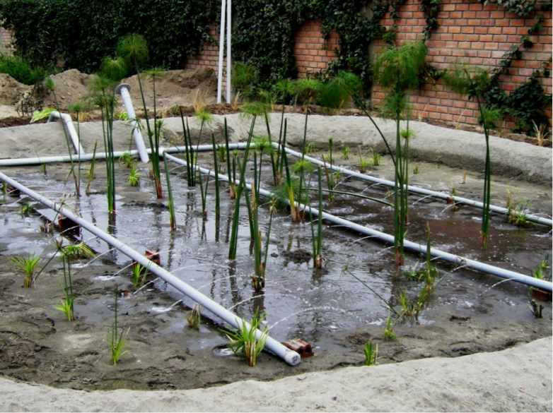

Slide 27
Operation & Maintenance
During the first growing season, it is important to remove weeds that can compete with the planted wetland vegetation. Distribution pipes should be cleaned once a year to remove sludge and biofilm that might block the holes.
With time, the gravel will become clogged by accumulated solids and bacterial film. Resting intervals may restore the hydraulic conductivity of the bed. If this does not help, the accumulated material has to be removed and clogged parts of the filter material replaced.
Maintenance activities should focus on ensuring that primary treatment is effective at reducing the concentration of solids in the wastewater before it enters the wetland.
Maintenance should also ensure that trees do not grow in the area as the roots can harm the liner.

Slide 28
Health Aspects & Acceptance
Pathogen removal is accomplished by natural decay, predation by higher organisms, and filtration. The risk of mosquito breeding is low since there is no standing water.
The system is generally aesthetic and can be integrated into wild areas or parklands.
Care should be taken to ensure that people do not come in contact with the influent because of the risk of infection.

Slide 29
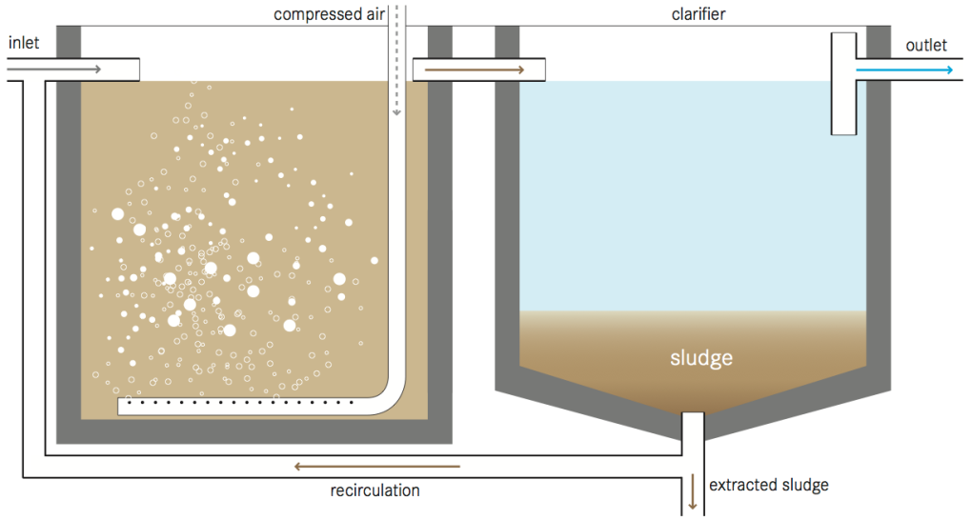
Activated sludge

Slide 30
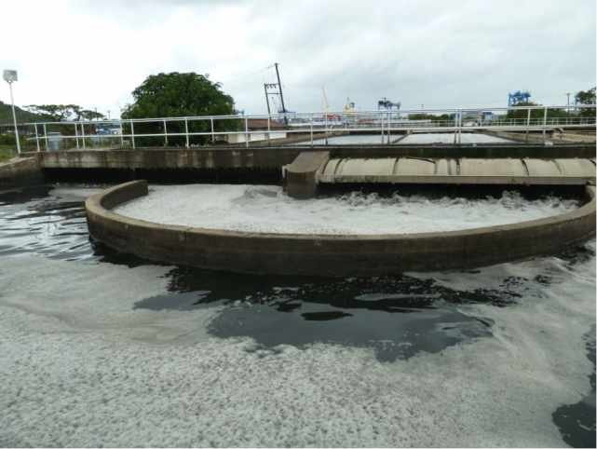

Slide 31
Operation & Maintenance
Highly trained staff is required for maintenance and trouble-shooting. The mechanical equipment (mixers, aerators and pumps) must be constantly maintained.
As well, the influent and effluent must be constantly monitored and the control parameters adjusted, if necessary, to avoid abnormalities that could kill the active biomass and the development of detrimental organisms which could impair the process (e.g., filamentous bacteria).

Slide 32
Health Aspects & Acceptance
Because of space requirements and odours, Centralized Treatment facilities are generally located in the periphery of densely populated areas.
Although the effluent produced is of high quality, it still poses a health risk and should not be directly handled. In the excess sludge pathogens are substantially reduced, but not eliminated.

